Slide 1
Data Center Infrastructure CT109-3-2&Version 2
Architecture Design and Standards Recommendation

Slide 2
Topic & Structure of The Lesson
Align design and architecture to business strategy, business impact decisions, design,space considerations and applicable standards.

Slide 3
Learning Outcomes
At the end of this topic, YOU should be able to:
Align design and architecture to business strategy today and into the future.
Business impact of decisions – looking at design from a TCO perspective over lifecycle.
External Shell design. Space considerations. Structural Specifications.
Applicable Standards – including fire resistance, fire suppression and security, etc.

Slide 4
Key Terms You Must Be Able To Use
If you have mastered this topic, you should be able to use the following terms correctly in your assignments and exams:
MTTR
SPOF
IAAS
SAAS
PAAS

Slide 5
Planning and Designing Data Centers
The volumes of data that must be processed are constantly increasing, demanding higher productivity in data centers. At the same time, data center operators need to keep their operational costs in check, improve profitability and eliminate sources of error that are potentially causing failures.
Statistics show that many failures occurring in data centers are caused by problems in the passive infrastructure or human error. Increasing availability starts with quality planning of the infrastructure and the cabling system.

Slide 6
Business Models and Services
Describe the services offered. What they have in common is that the operator provides and manages the data center's infrastructure.
However, not every supplier of data center services actually runs his/her own data center. There are different business models in this area as well:
The supplier is renting space from a data center operator;
He acts as reseller for this data center operator;
He is renting the space according to need.

Slide 7
Housing and Hosting
In the case of housing services, the operator provides the rented data center space plus cabling. The customer usually supplies his own servers, switches, firewalls, etc. The equipment is managed by the customer or a hired third party.
In the case of hosting services, the web host provides space on a server or storage space for use by the customer, and he/she also provides Internet connectivity. The services include web hosting, share hosting, file hosting, free hosting, application service provider (ASP), Internet service provider (ISP), full service provider (FSP), cloud computing provider, and more.

Slide 8
Managed services and managed hosted
In both managed services and managed hosting, the contracting parties agree on specific services on a case by-case basis. All conceivable combinations are possible; data center operators running the clients' servers, including the operating system level, or data center operators providing the servers for their clients, etc.

Slide 9
Cloud services
Even less clearly defined are the cloud services. Since they are a trend topic, nearly every company is offering cloud services, for example SaaS (Software as a Service), IaaS (Infrastructure as a Service), PaaS (Platform as a Service) or S+S (Software plus Service). It is important to first establish the specific components of a product portfolio.

Slide 10
Space terms in data center
Collocation (also spelled colocation) stands for a space or a room in a data center rented for the customer's own IT equipment. The term open collocation usually refers to a space shared by several customers.
Cage – suite – room refer to a separate room or lockable section in a data center. This separate section is reserved for the exclusive use of the customer's IT equipment. The section's design depends on the operator but customers usually decide on matters such as cabling and infrastructure in these sections.

Slide 11
Space terms in data center
Rack – cabinet: These terms are used interchangeably. Depending on the data center operator and the rented space, the customer can decide on the models to use. Sometimes ¼ and ½ racks are available. Particularly in hosting services, the number of height units is also relevant.

Slide 12
Typology Overview
There is no information available on the total number of data centers worldwide and their differentiation and classification in terms of types and sizes.
Different authors and organizations classify data centers into different types, but a globally applicable, consistent categorization does not yet exist. The approaches differ with regard to a data center’s purpose. They are:

Slide 13
Typology based on statistics
This typology has been applied to provide information about the energy consumption of data centers (see US-EPA 2007, TU Berlin 2008, Bailey et al. 2007). US-EPA uses the following terms, among others: server closet, server room, localized data center, mid-tier data center, enterprise-class data center.
The German Federal Environment Agency further developed and refined the approach in a study of resources and energy consumption, published in November 2010.

Slide 14
Typology based on data center availability
Reliability or availability is an essential quality criterion of a data center. There are a number of data center classifications based on availability

Slide 15
Typology based on data center purpose
In many cases, data centers are classified on the basis of the underlying business model, e.g. housing and collocation data centers, high-performance data centers, and others.

Slide 16
Typology based on operator type
Suppliers of data centers often categorize data centers by their operators, e.g. by industry sector (bank, automobile, research, telecommunication, etc.) or in terms of public authorities or private companies.
Another categorization distinguishes between enterprise data centers and service data centers.
Enterprise Data Centers (company-owned) Data centers performing all IT services for a company and belonging to that company (be it in the form of an independent company or a department).

Slide 17
Typology based on operator type
Service Data Centers (service providers) Data centers specialized in providing data center services for third parties. Typical services are housing, hosting, collocation and managed services, and exchange services for the exchange of data.

Slide 18
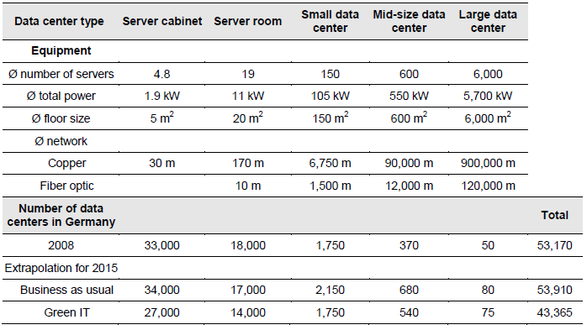
Number and Size of Data Centers

Slide 19
Classes (Downtime and Redundancy)
The best-known classification system defines availability in data centers for both physical structures and technical facilities and was developed by the Uptime Institute. The Institute was founded in 1993, is based in Santa Fe (Mexico) and numbers approx. 100 members. The tier classes I to IV define the probability that a system will be functional over a specified period of time. SPOF (Single Point of Failure) refers to the component of the system, whose failure causes the entire system to collapse. There can be no SPOF in a high-availability system.

Slide 20
Tiers I – IV
Among other factors, the tier classification is based on the elements of a data center's infrastructure. The lowest value of the individual element (cooling, power supply, communication, monitoring, etc.) determines its overall evaluation. Also taken into account is the sustainability of measures, operational processes and service assurance.
This is particularly evident in the transition from Tier II to Tier III, where the alternative supply path allows maintenance work to be performed without interfering with the operation of the data center, which in turn is manifested in the MTTR value (Mean Time to Repair).

Slide 21
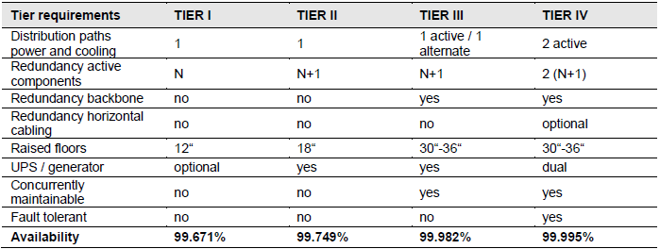

Slide 22
Tier I
This class is appropriate for smaller companies and start-ups. There is no need for extranet applications, Internet use is mainly passive and availability is not a top priority.
A Tier I data center basically has non-redundant capacity components and single non-redundant distribution networks. An emergency power supply, uninterruptible power supply and raised floors are not required, maintenance and repair work are scheduled and failures of site infrastructure components will cause disruption of the data center.

Slide 23
Tier II
This is the class for companies that have already moved part of their business processes online, mostly during standard office and business hours. In the event of non-availability there will be delays but no data loss. There are no business-critical delays (non-time critical backups).
A Tier II data center has redundant capacity components (N+1) and single non-redundant distribution networks. An uninterruptible power supply and raised floors are required.

Slide 24
Tier III & IV
These are the classes for companies that use their IT equipment for internal and external electronic business processes and require 24-hour availability. Maintenance work or shut-down times have no damaging effects. Tier III and IV are the basis for companies operating in e-commerce, electronic market transactions or financial services (high-reliability security backups).
A Tier III data center has redundant capacity components and multiple distribution networks that serve the site's computer equipment. Generally, only one distribution network serves the computer equipment at any time.

Slide 25
Classification Impact on Communications Cabling
A fault-tolerant (Tier IV) data center has redundant capacity components and multiple distribution networks simultaneously serving the site's computer equipment. All IT equipment is dual powered and installed properly so as to be compatible with the topology of the site's architecture.

Slide 26
Classification Impact on Communications Cabling
To ensure availability and reliability of the communications network in a data center, a redundant cabling configuration is required, in accordance with the respective Tier level.

Slide 27
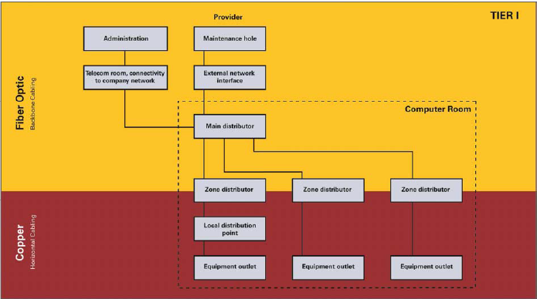

Slide 28
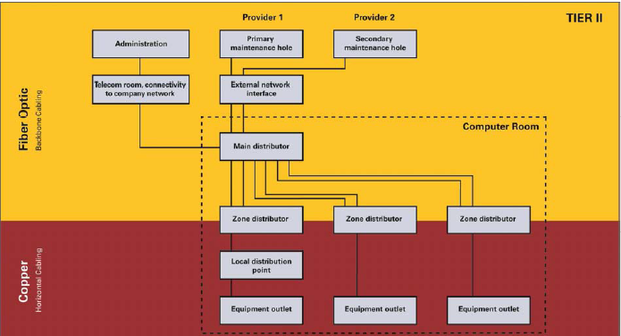

Slide 29
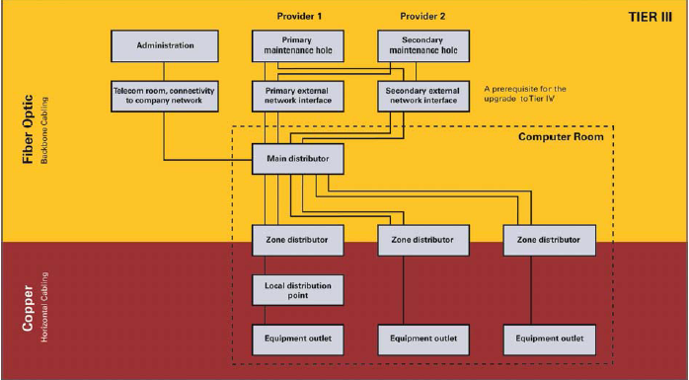

Slide 30
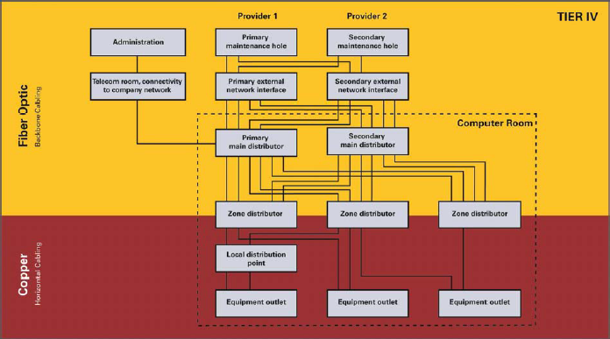

Slide 31
Quick Review Question
Compare housing services with hosting services
Briefly explain Tier 1,Tier II and Tier III data centers
Explain the term colocation

Slide 32
Summary of Main Teaching Points
Discussed design and architecture to business strategy, business impact decisions, design, space considerations and applicable standards.

Slide 33
Question and Answer Session
Q & A

Slide 34
What we will cover next
Raised Access Floor, connecting the infrastructure with copper and fibre.

